Slide 1
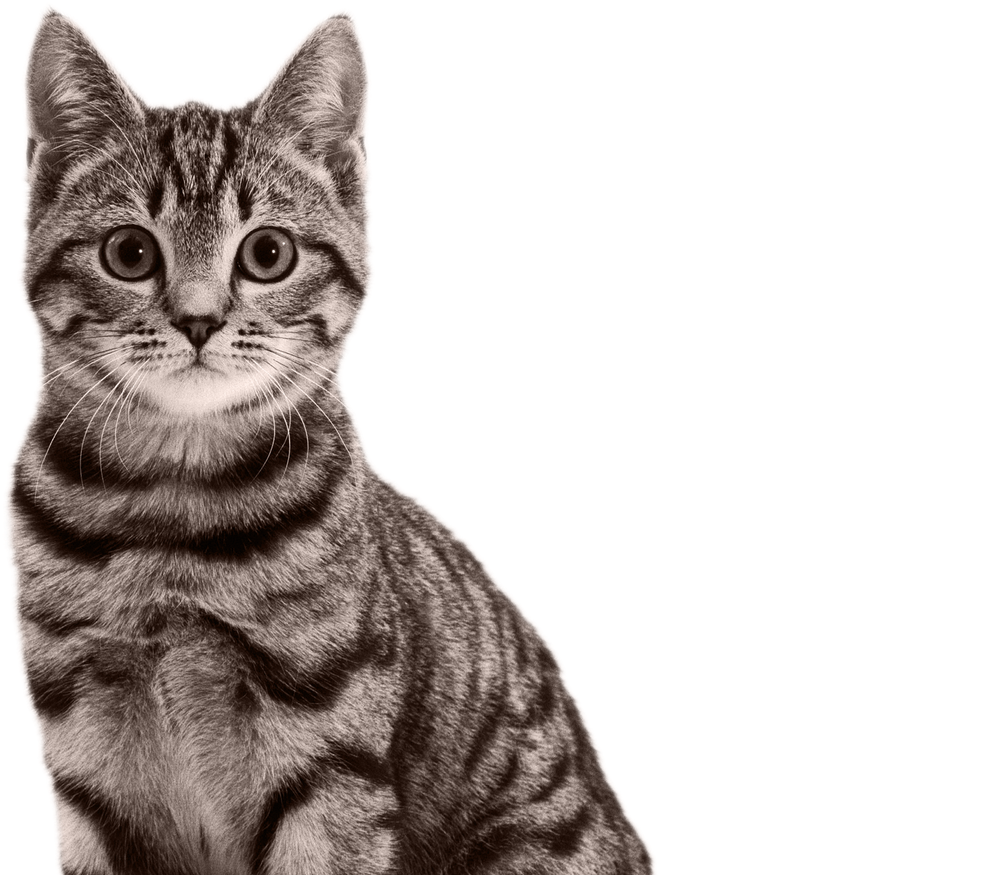


Cats acoustic data Project
Bony Audrey
Lagroy de Croutte de Saint Martin Anne-Victoire
February 4th, 2021
Supervisors : Amandine Shmutz (Mars)
François Husson (Agrocampus Ouest)

Slide 2
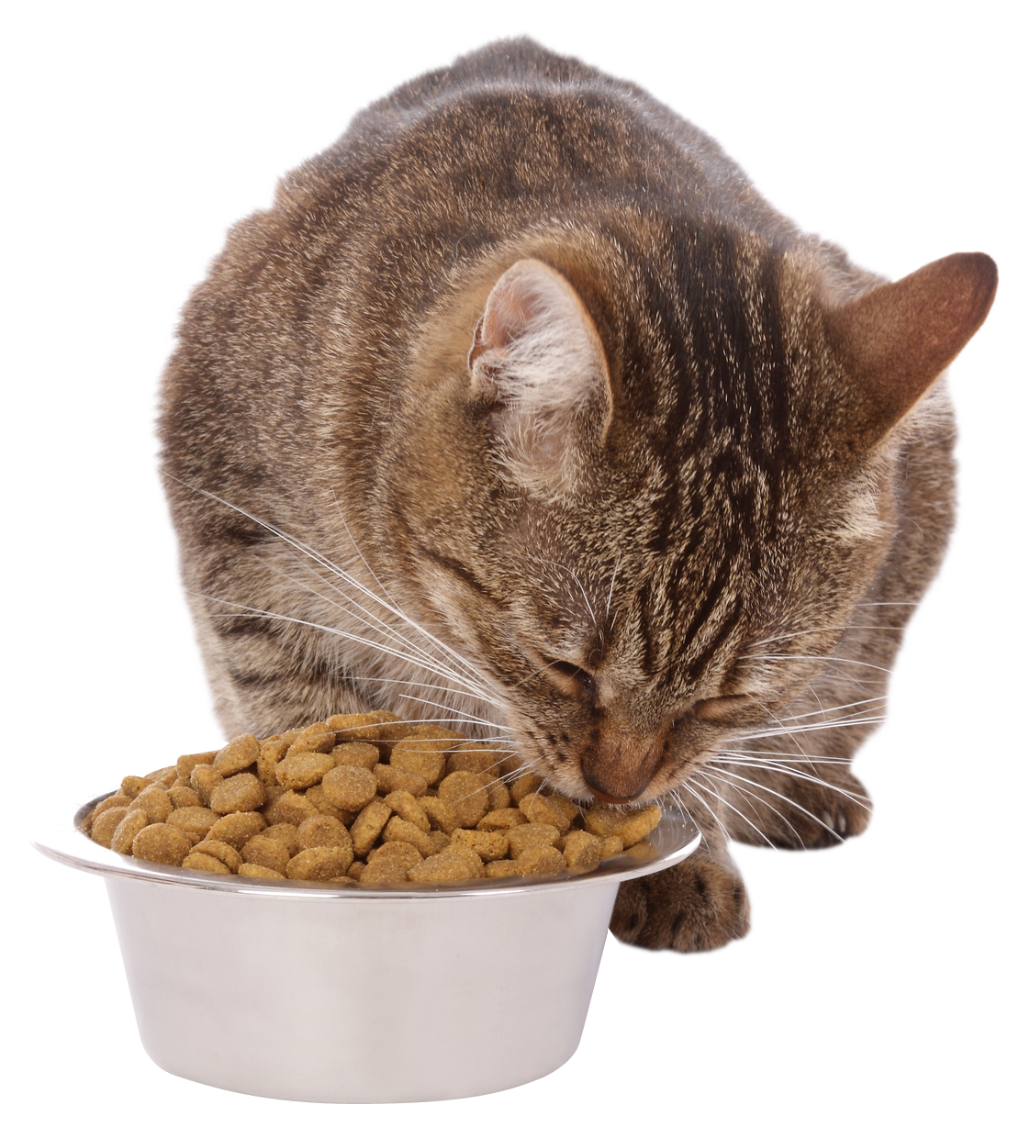
Data – Context
Automation of data acquisition
Task to be digitised: Counting of breaks and chewing when cats eat treats from video recordings.
Test of an acquisition protocol for event
detection
Notes:
Mars
Automatisation des acquisitions de données Tâche à digitaliser : Comptage des crocs et mastications lors de la consummation de friandises. Aujourd’hui à partir d’enregistrement vidéo
Test d’un protocole de detection d’événements, données acquises par un micro porter par les chats
Image : https://www.pinterest.fr/pin/568931365426236282/ (Verlina)

Slide 3
Data – Issues
Does the data acquisition method allow enough data quality for event counting ?
Does audio data allow the detection of events?

Slide 4
Data – Overview
I – Quality of the micro on the collar Data
II – Event counting from audio recording

Slide 5
I – Quality of data

Slide 6
I- Data – Visualisation
Notes:
Présentation des graph amplitudes et spectro

Slide 7
I- Data – Listening recordings

Slide 8
I- Data manipulation – Filtering frequencies

Slide 9
I- Data manipulation – Filtering frequencies

Slide 10
II- Creation of a new data set a. Methodology

Slide 11
II- Creation of a new data set a. Methodology

